Slide 1
CREATE
CHATBOT IN PYTHON
PRESENTED BY:
S.VIGNESHWARAN
912421104054

Slide 2
Phase2 : innoVaTion

Slide 3
PuTTinG desiGn inTo innoVaTion:
1. Problem Statement
2. Research and Analysis
3. Design and Development
4. Implementation and Testing
5. Documentation
6. Assessment

Slide 4

ProBleM sTaTeMenT:
In this phase, we will explore innovative
techniques such as ensemble methods and
deep learning architectures to improve the
prediction system's accuracy and
robustness. We will also consider using pre
-trained language models like GPT-3 to
enhance the quality of responses. Finally,
we will put our design into innovation to
solve the problem, and document the
complete steps taken for assessment.

Slide 5

research and analysis:
The first step in the design and
development phase is to conduct
thorough research and analysis to
determine the feasibility and
effectiveness of the proposed
innovations. We will review existing
literature and case studies on ensemble
methods, deep learning architectures,
and pre-trained language models to
understand their potential benefits and
limitations for our prediction system. We
will also analyze the data sets and
identify any potential biases or gaps in
the data that could impact the accuracy
and robustness of the system.

Slide 6

desiGn and deVeloPMenT:
Based on the research and analysis, we
will design and develop a new prediction
system that incorporates the advanced
techniques identified in the previous
phase. We will create a detailed plan
outlining the steps involved in
implementing the new system and ensure
that it aligns with our goals and objectives.
We will also establish benchmarks and
metrics to measure the effectiveness and
success of the new system.

Slide 7

iMPleMenTaTion and TesTinG:
Once the system has been designed and
developed, we will move on to the
implementation and testing phase. During
this phase, we will deploy the system in a
live environment and test its performance
under real-world conditions. We will also
conduct extensive testing to ensure that the
system is accurate, reliable, and robust.
This testing will involve using a variety of
data sets and performance metrics to
evaluate the system's performance and
identify areas for improvement. We will
work closely with the client to ensure that
the system meets their requirements and
expectations.

Slide 8

docuMenTaTion:
In this phase, we will create a
comprehensive document outlining the
complete steps taken to put our design into
innovation and solve the problem.
This documentation will include detailed
descriptions of the system's components,
algorithms, and performance metrics.
We will also provide user manuals and
technical documentation to help the client
understand how to use and maintain the
system. This documentation will be critical
for future maintenance and upgrades to the
system. This document will be shared for
assessment.

Slide 9

assessMenT:
After completing the implementation and
testing phase, we will create a detailed
document outlining the complete steps taken
to put our design into innovation and solve
the problem. This document will include a
summary of the problem statement, research
and analysis conducted, design and
development process, and implementation
and testing results.
The document will also include an
assessment of the effectiveness of our
solution, including any limitations or areas
for improvement. We will present this
document to the stakeholders for their
review and feedback.

Slide 10
enseMBle MeThods:
Ensemble methods involve combining multiple models to improve the accuracy and robustness of the
prediction system. This can be achieved through techniques such as bagging, boosting, and stacking.
Bagging:
Bagging involves creating multiple models using different subsets of the training data and aggregating
their predictions. This can reduce overfitting and improve the accuracy and stability of the model.
Boosting:
Boosting involves creating a series of models that are trained sequentially, with each subsequent model
focusing on the samples that were misclassified by the previous model. This can improve the accuracy of the
model by focusing on the difficult samples.
Stacking:
Stacking involves combining the predictions of multiple models using a meta-model. The meta-model learns
from the predictions of the base models and can improve the accuracy and robustness of the prediction
system.

Slide 11
deeP learninG archiTecTures:
Convolutional Neural Networks (CNNs):
CNNs are widely used in image and video recognition tasks. They consist of multiple layers of
convolutional and pooling operations that extract features from the input data.
Recurrent Neural Networks (RNNs):
RNNs are commonly used in natural language processing tasks. They have a feedback loop that
allows them to process sequences of data, such as sentences or speech.
Generative Adversarial Networks (GANs):
GANs are used for generating new data that is similar to the training data. They consist of a
generator network that creates new samples and a discriminator network that evaluates the
quality of the generated samples.

Slide 12
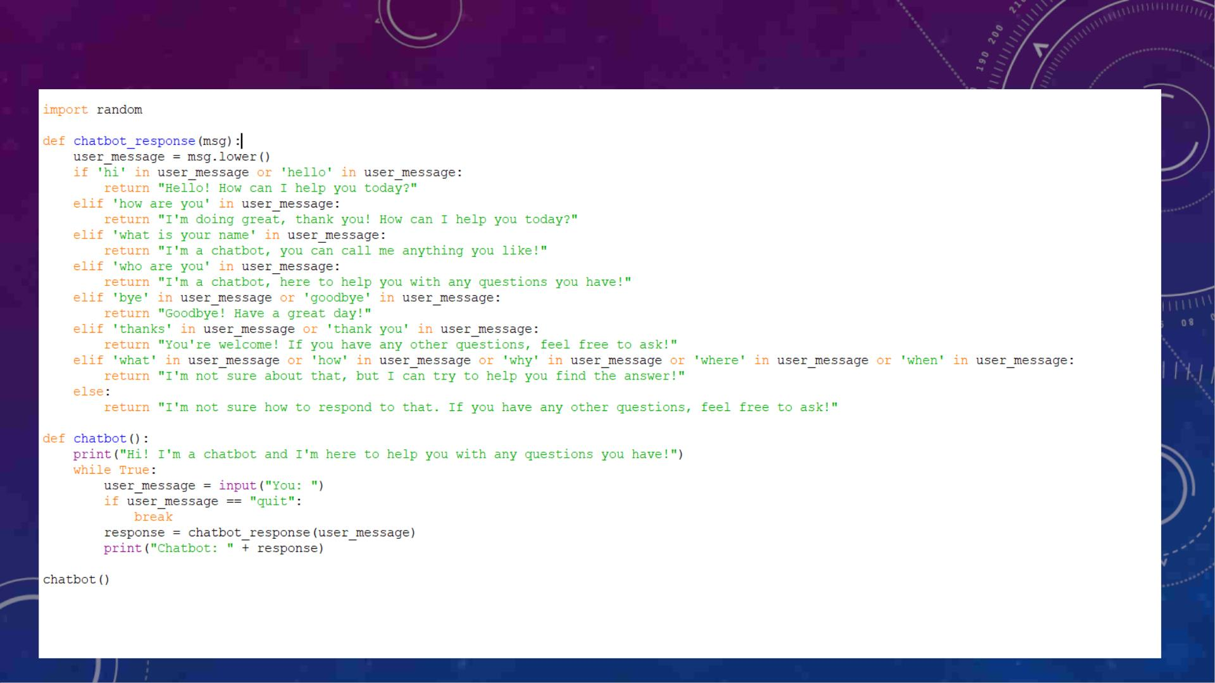
saMPle PyThon ProGraM oF chaTBoT:

Slide 13
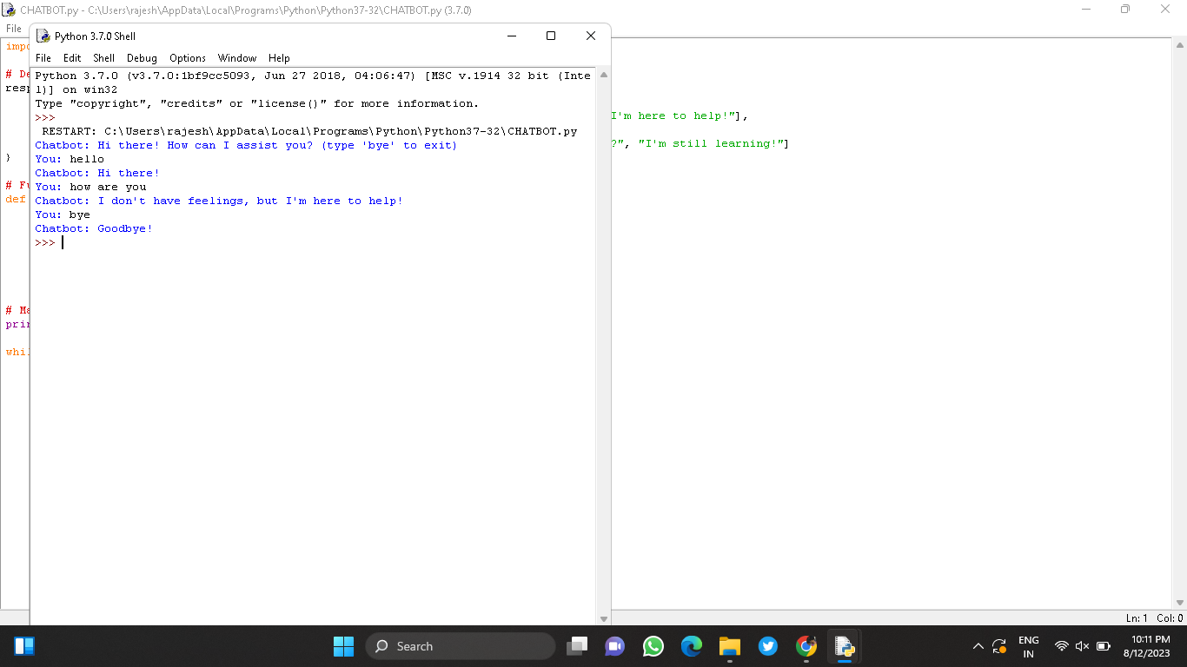
ouTPuT:

Slide 14
conclusion
In this phase, we explored innovative techniques such as ensemble methods,
deep learning architectures, and pre-trained language models to improve the
prediction system's accuracy and robustness. We also put our design into
innovation by following a structured approach of problem statement, research
and analysis, design and development, implementation and testing,
documentation, and assessment.

